Slide 1
SAP BTP Extension Suite Training
Day 2
Anubhav Oberoy
www.AnubhavTrainings.com
Follow excellence with sheer passion

Slide 2
Agenda – Day 2
01
04
Challenges of building Apps on BTP
CDS – Core Data and Services
02
05
CAPM Introduction
Reuse Types and aspects
03
06
Challenges of building DB
Introduction to CDS Views

Slide 3
Agenda – Day 2
07
10
Testing Services in BAS
Title
08
11
Actions and Functions
Title
09
12
Generic Handlers in CAP
Title

Slide 4
Challenges of building Apps on BTP
What is the best-practice/ gold-standard to build sap btp applications, recommendation by SAP
Are there any existing sample apps which we can follow to build our app
Many times, as a developer it is hard to add each part of app like files, dependencies, deploy descriptor, lots of code. Can this process be simplified?
How can we have reusability of the code to speed up my development and use sap provided tools to generate the skeleton of the apps
As a developer we want to focus more on functional aspect implementation rather initial project setup
Our apps are sometime tightly coupled with DB technology, develop DB agnostic apps
No matter what is the area we belong FIN, SD, MM, PP, PM, APO, CRM, HR etc. eventually as a developer we all do same work. Design tables, write logic, build UI
How to develop software in BTP, which does not require too much time in handovers
SAP CAPM – Cloud Application Programming Model
It’s a SAP provided framework to develop SaaS apps in BTP which is PaaS. If the developer wants to use open source technologies like Node and Java. Great cost saving and freedom of choice of technology and consultants available easily in market.
SAP RAP – Restful Application Programming Model
It is based on ABAP on Cloud. We can build extensions and SaaS application using this framework. The skill required will be ABAP and CDS knowledge. The deployment is very costly as compared to open-source technologies used in CAP.

Slide 5
CAPM Introduction
CAPM is a framework of (a framework is a collection of libraries, classes, function, attributes, events)
Languages – Java and Node JS
Libraries – Node modules like cds, cds-dk etc.
And Tools – VS Code or BAS
The framework can be used to build native cloud applications:
Full stack applications → database, application layer, service layer and UI layer (Presentation layer)
Extend existing application → Side by Side extensibility using S/4HANA cloud SDK

Slide 6
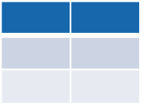
Challenges of building DB
Many times developers end up using a technology which is tightly coupled to DB. Which means when we change database, we have to re-write our entire application again.
Developer
If I have written 2mn SQL statements in our application, we end up re-writing all these statements again just to change database technology.
What we want?
To develop application in a way that we should not couple our app code tightly with DB. We want to develop in DB agnostic manner.
CREATE TABLE tab COLUMNS c1 int, c2 char;
CREATE TABLE tab COLUMNS
c1 : integer;
c2 : varchar length 30;
SQL Server
Oracle DB

Slide 7
CDS – Core Data and Services
CDS is a concept which allows us to get rid of SQL. It is an extension of SQL (what SQL can do, cds can also do). We need to create a design time artefact with an extension called .cds for almost everything e.g. database objects, services, Ui's. the CAPM framework will compile this file and generate the necessary statements and artefacts. CAP framework comes with a library called @sap/cds which is responsible for the compilation of cds artefacts. In order to use this library we need to install it at project level. CAPM also comes with the required tooling to generate your project skeleton, that is also comes with a library called @sap/cds-dk.
.cds
Design time artefact
@sap/cds
Runtime artifacts generated as per database

Slide 8
Solution – use CAP framework
entity tab{
c1 number,
c2 string(20)
};
https://cap.cloud.sap/
Design time artefact
.cds
CAPM Framework
SQLite
@sap/cds
CDS Engine
HANA
SQL Code
Database Agnostic

Slide 9
Hands on: Modules for using CAP
We need to install sap cds-dk (Development kit), This kit includes required framework libraries and source code to build, test, deploy, run cap applications. It comes along with cds CLI which will be used by developers to quickly generate the cap project skeleton. This module needs to be installed globally in our system if we are using VS Code, in case we use BAS, this module is pre-installed.
npm install -g @sap/cds-dk
node version >= 14
Check if the CAP is installed in my system ➔ cds –v & cds --help
Create a folder in our computer, and run cds init command. This will create a project skeleton automatically which includes db, srv, ui folders.
If you want to quickly manage multiple node versions in your computer you can use nvm tool - https://github.com/coreybutler/nvm-windows/releases
When we make constant changes to the project, we want project to detect a correction and automatically restart the server. We can use the cds watch command instead of cds run

Slide 10
DB Design
Addresses
1..1
Business partner
(Customers, Suppliers)
1..*
Purchase order
Product Text
(localized)
1..*
1..*
Purchase order Items
1..1
Product

Slide 11

Hands on: Create DB Module
Solution:
https://github.com/soyuztechnologies/SAP_BTP_Training_8Hr_Per_Day/tree/master/Day%202/01db

Slide 12
Reuse Types and aspects
When we design database artefacts, at times we have many similar objects and their data types. Instead of hardcoding the type as primitive type, it is recommended to create custom data types. Using custom data type increase reusability and reduce maintenance.
When we create a separate CDS file for reuse purpose and consume it. This file contain types, enumerators and aspects.
Every project would need some common aspects and types related to primary key generation, admin data (created by, created on, changed by, changed on) – temporal, Currency.
Aspect (structures in abap) is combination of many fields.

Slide 13

Hands on: Service creation
Solution:
https://github.com/soyuztechnologies/SAP_BTP_Training_8Hr_Per_Day/tree/master/Day%202/02srv

Slide 14
Views – (CDS Views)

Slide 15
Introduction to CDS Views
1. Usually we have all our data distributed across multiple tables, and if we need to get this data out, we need to write complex queries with joins. It becomes very complex to handle the maintenance of these large queries. Views will simplify the consumption and make it easy to maintenance.
2. We can perform operations like aggregation on the view.
3. Security
4. CDS views are also the contracts for data consumption
5. They include annotations which drive functionality.
6. View provide lose coupling to load data. Whereas when we use queries and joins, they are always tight coupling.
Purchase order
Purchase order items
Load what is needed

Slide 16
Hand – on: CDS Views
Exercise:
https://github.com/soyuztechnologies/SAP_BTP_Training_8Hr_Per_Day/blob/master/Day%202/01db/CDSViews.cds

Slide 17
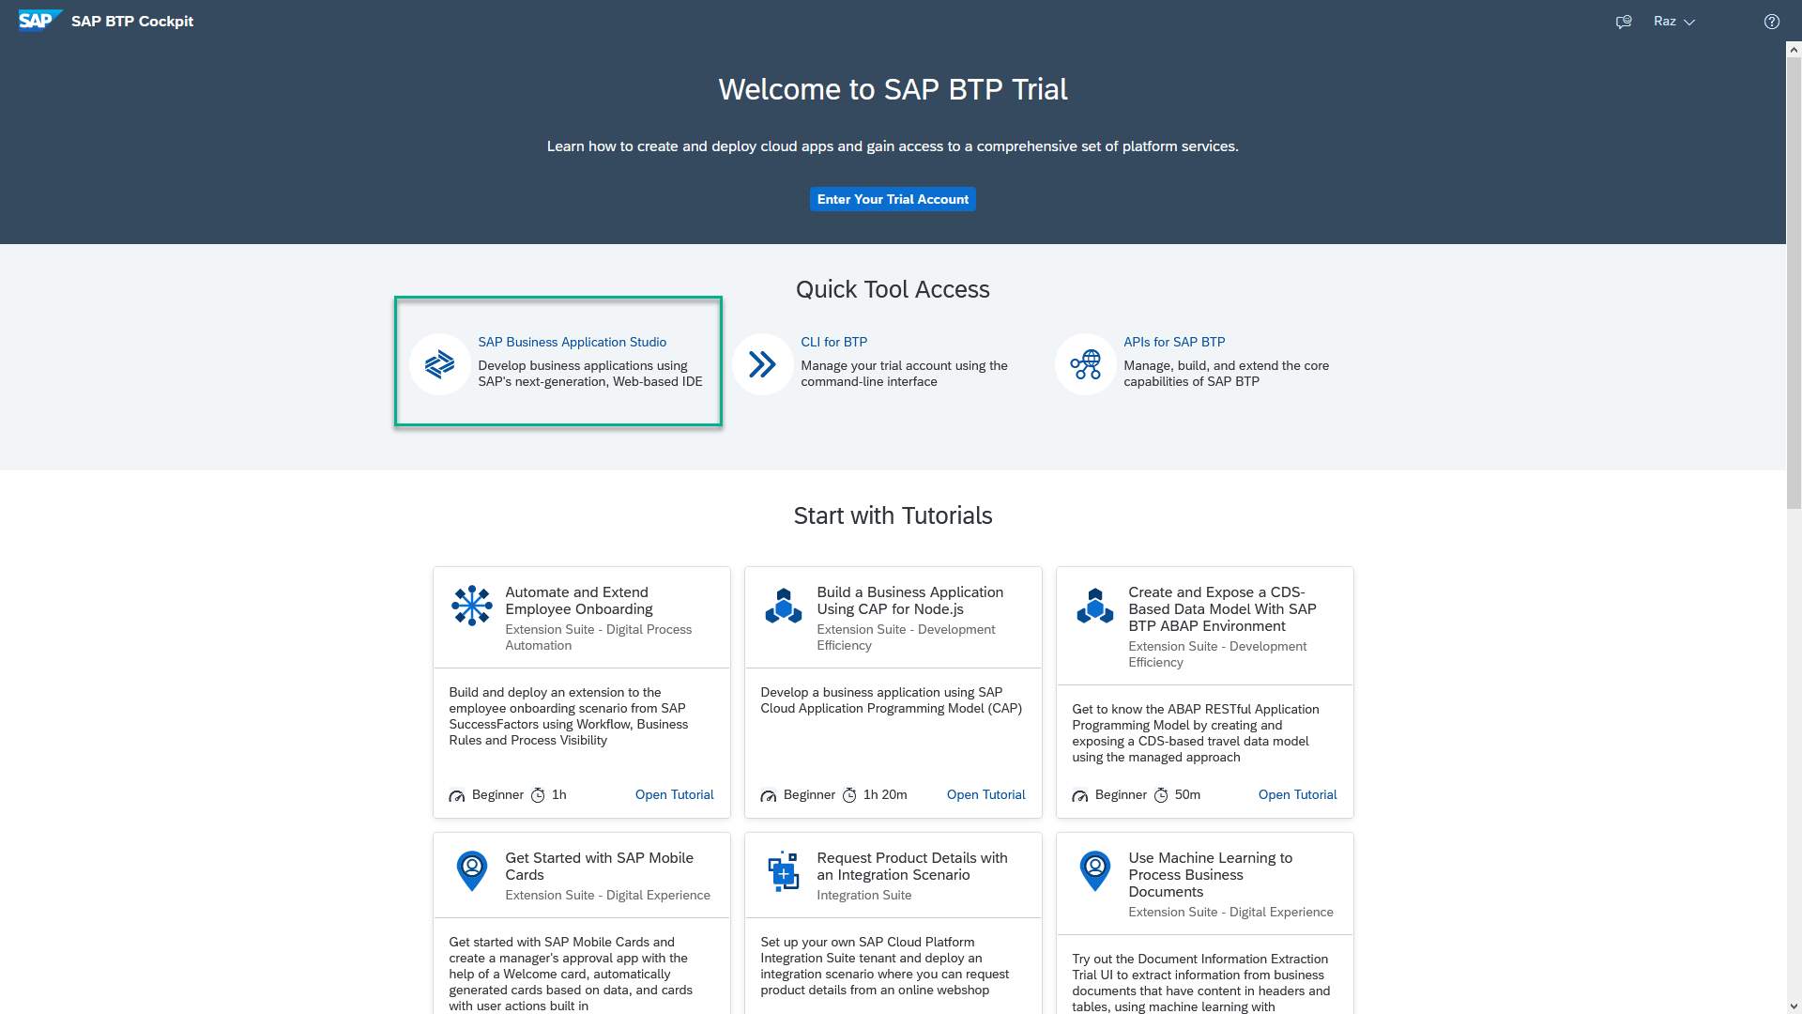
Business Application Studio
SAP Business Application Studio is a development environment available on SAP Business Technology Platform. Before you can start developing using SAP Business Application Studio, administrators must perform the required onboarding steps that are described in this tutorial.
In an Enterprise Account you can set up SAP Business Application Studio as a Free-Tier service by checking its free plan during its entitlement configuration.

Slide 18
Dev Space in BAS
We don’t want a single developer to consume all the available resources
We want a clear isolation of one developer with another
Pre-configured by sap for specific development
Solution - Virtualize
Dev Space
Dev Space
Dev Space
SAP BAS – Business App Studio
SAP BTP – Platform as a Service
IaaS – Infrastructure as a Service

Slide 19

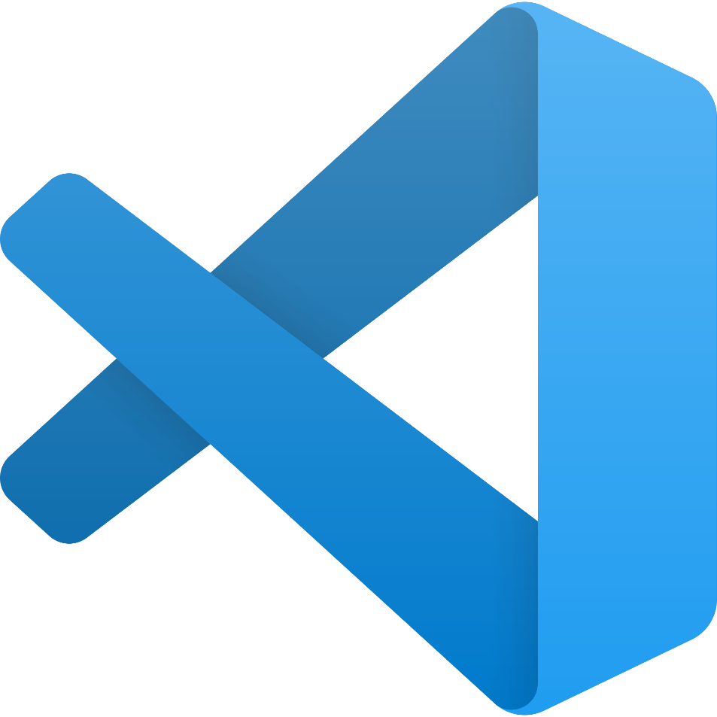
Hands on: Move App to BAS

Slide 20
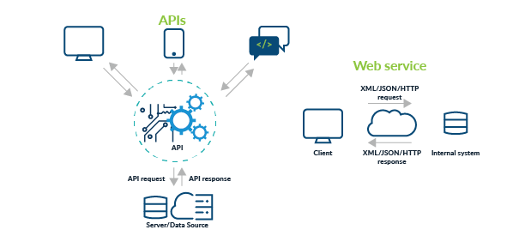
Testing Services in BAS
Exercise:
https://github.com/soyuztechnologies/SAP_BTP_Training_8Hr_Per_Day/blob/master/Day%202/02srv/tester.http

Slide 21
Actions and Functions
In addition to common CRUD operations, you can declare domain-specific custom operations as shown below. These custom operations always need custom implementations in corresponding events handlers.
Actions vs Functions
The differentiation between Actions and Functions stems from the OData specifications and in essence is as follows:
Actions are meant for operations, which add or modify data in the server; they are called through POST request with the arguments passed in application/json bodies.
Functions are meant for operations, which only retrieve data from the server; they are called through GET requests with the arguments passed in the URL path.

Slide 22
Hands – on: Actions & Functions
Exercise:
https://github.com/soyuztechnologies/SAP_BTP_Training_8Hr_Per_Day/blob/master/Day%202/02srv/CatalogService.cds
https://github.com/soyuztechnologies/SAP_BTP_Training_8Hr_Per_Day/blob/master/Day%202/02srv/CatalogService.js

Slide 23
Pagination

Slide 24
Behind the scenes

Slide 25
Generic Handlers in CAP
The CAPM framework generates most of the code to perform CURDQ operations on the entity. It does not know what validations to perform on our business data. As a developer, when we want to attach a pre-check (validations) / post-check (post processing code) on an entity operation, we can use generic handlers. All these operations are performed SYNCHRONOUSLY.
At times we want to
Take full control of our implementation
We want to add some validation before data is inserted or updated
We want to change data before insert/update
Read some extra information while GET calls
Fiori app
odata
cap
Generic handlers
database
before
on
after

Slide 26

Hands on: Generic Handlers
Exercise:
https://github.com/soyuztechnologies/SAP_BTP_Training_8Hr_Per_Day/blob/master/Day%202/02srv/MyService.cds
https://github.com/soyuztechnologies/SAP_BTP_Training_8Hr_Per_Day/blob/master/Day%202/02srv/MyService.js

Slide 27
Syntax
this.when(‘WHICH’, what, () => {
code.
})
when – before, after, on
Which – CREATE, UPDATE, DELETE, READ
What – Entity (Employee, Pos, …)

Slide 28

What We Did
Let’s Summarize

Slide 29

www.anubhavtrainings.com
Thank You
End of Day 2

Slide 30

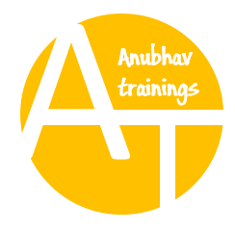

We’re committed to empower you to be
#FutureReady
through powerful training solutions.
We build the workforce of the future.
250+
Corporate Clients
30,000+
Learners Trained
25000+
Learners Placed
FREE WEBINARS
Sign up for free webinars with industry experts every fortnight!
Enroll Now!
Contact us today!
https://anubhavtrainings.com

